Slide 1
Processor Design and Assembly Language
Dheeraj, Aparna, Brijesh, Karthik

Slide 2
Specification
ISA: RV32I (little endian)
HDL: Verilog
Simulator: Altera-Intel Quartus tool
Number of Registers: 32
Size of Register: 32 bits
Assembler Language: C++
Waterman, A. S. (2016). Design of the RISC-V instruction set architecture (Doctoral dissertation, UC Berkeley).

Slide 3
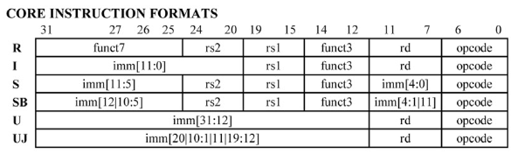
Instruction format

Slide 4
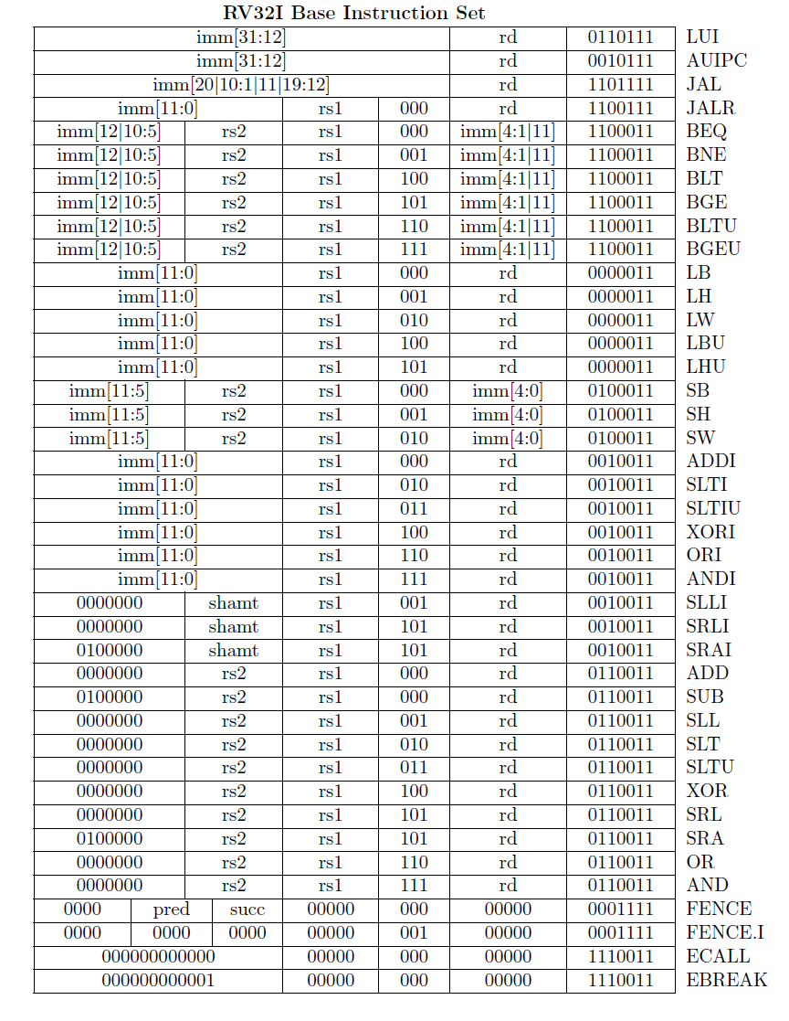

Slide 5
Instruction Set

Slide 6
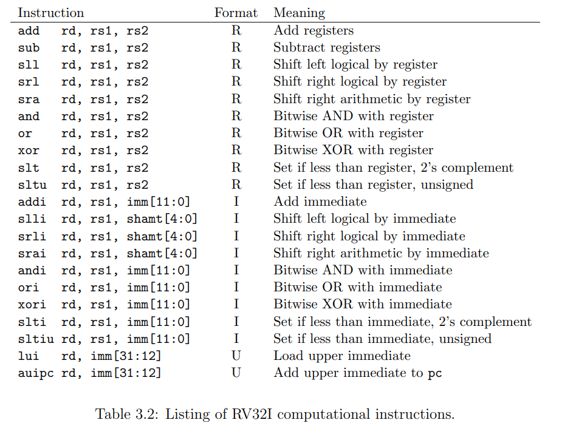

Slide 7
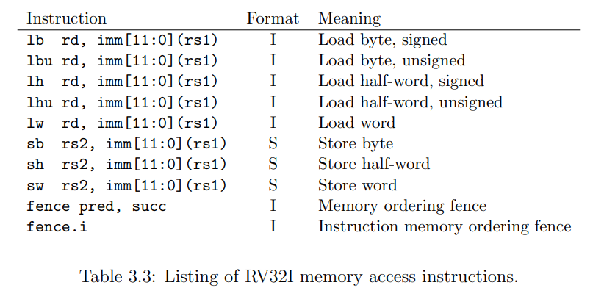

Slide 8
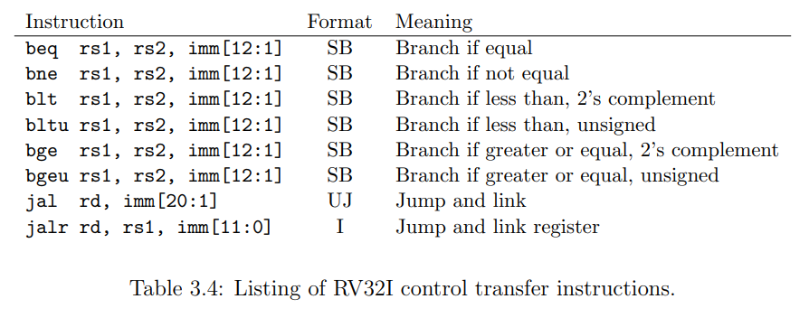

Slide 9
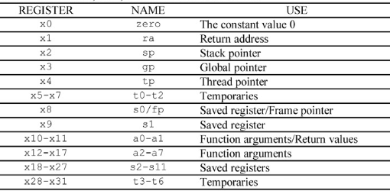
Registers

